Slide 1
Outline of Python Basics
Python Install
IDE Introduction
Code Examples

Slide 2
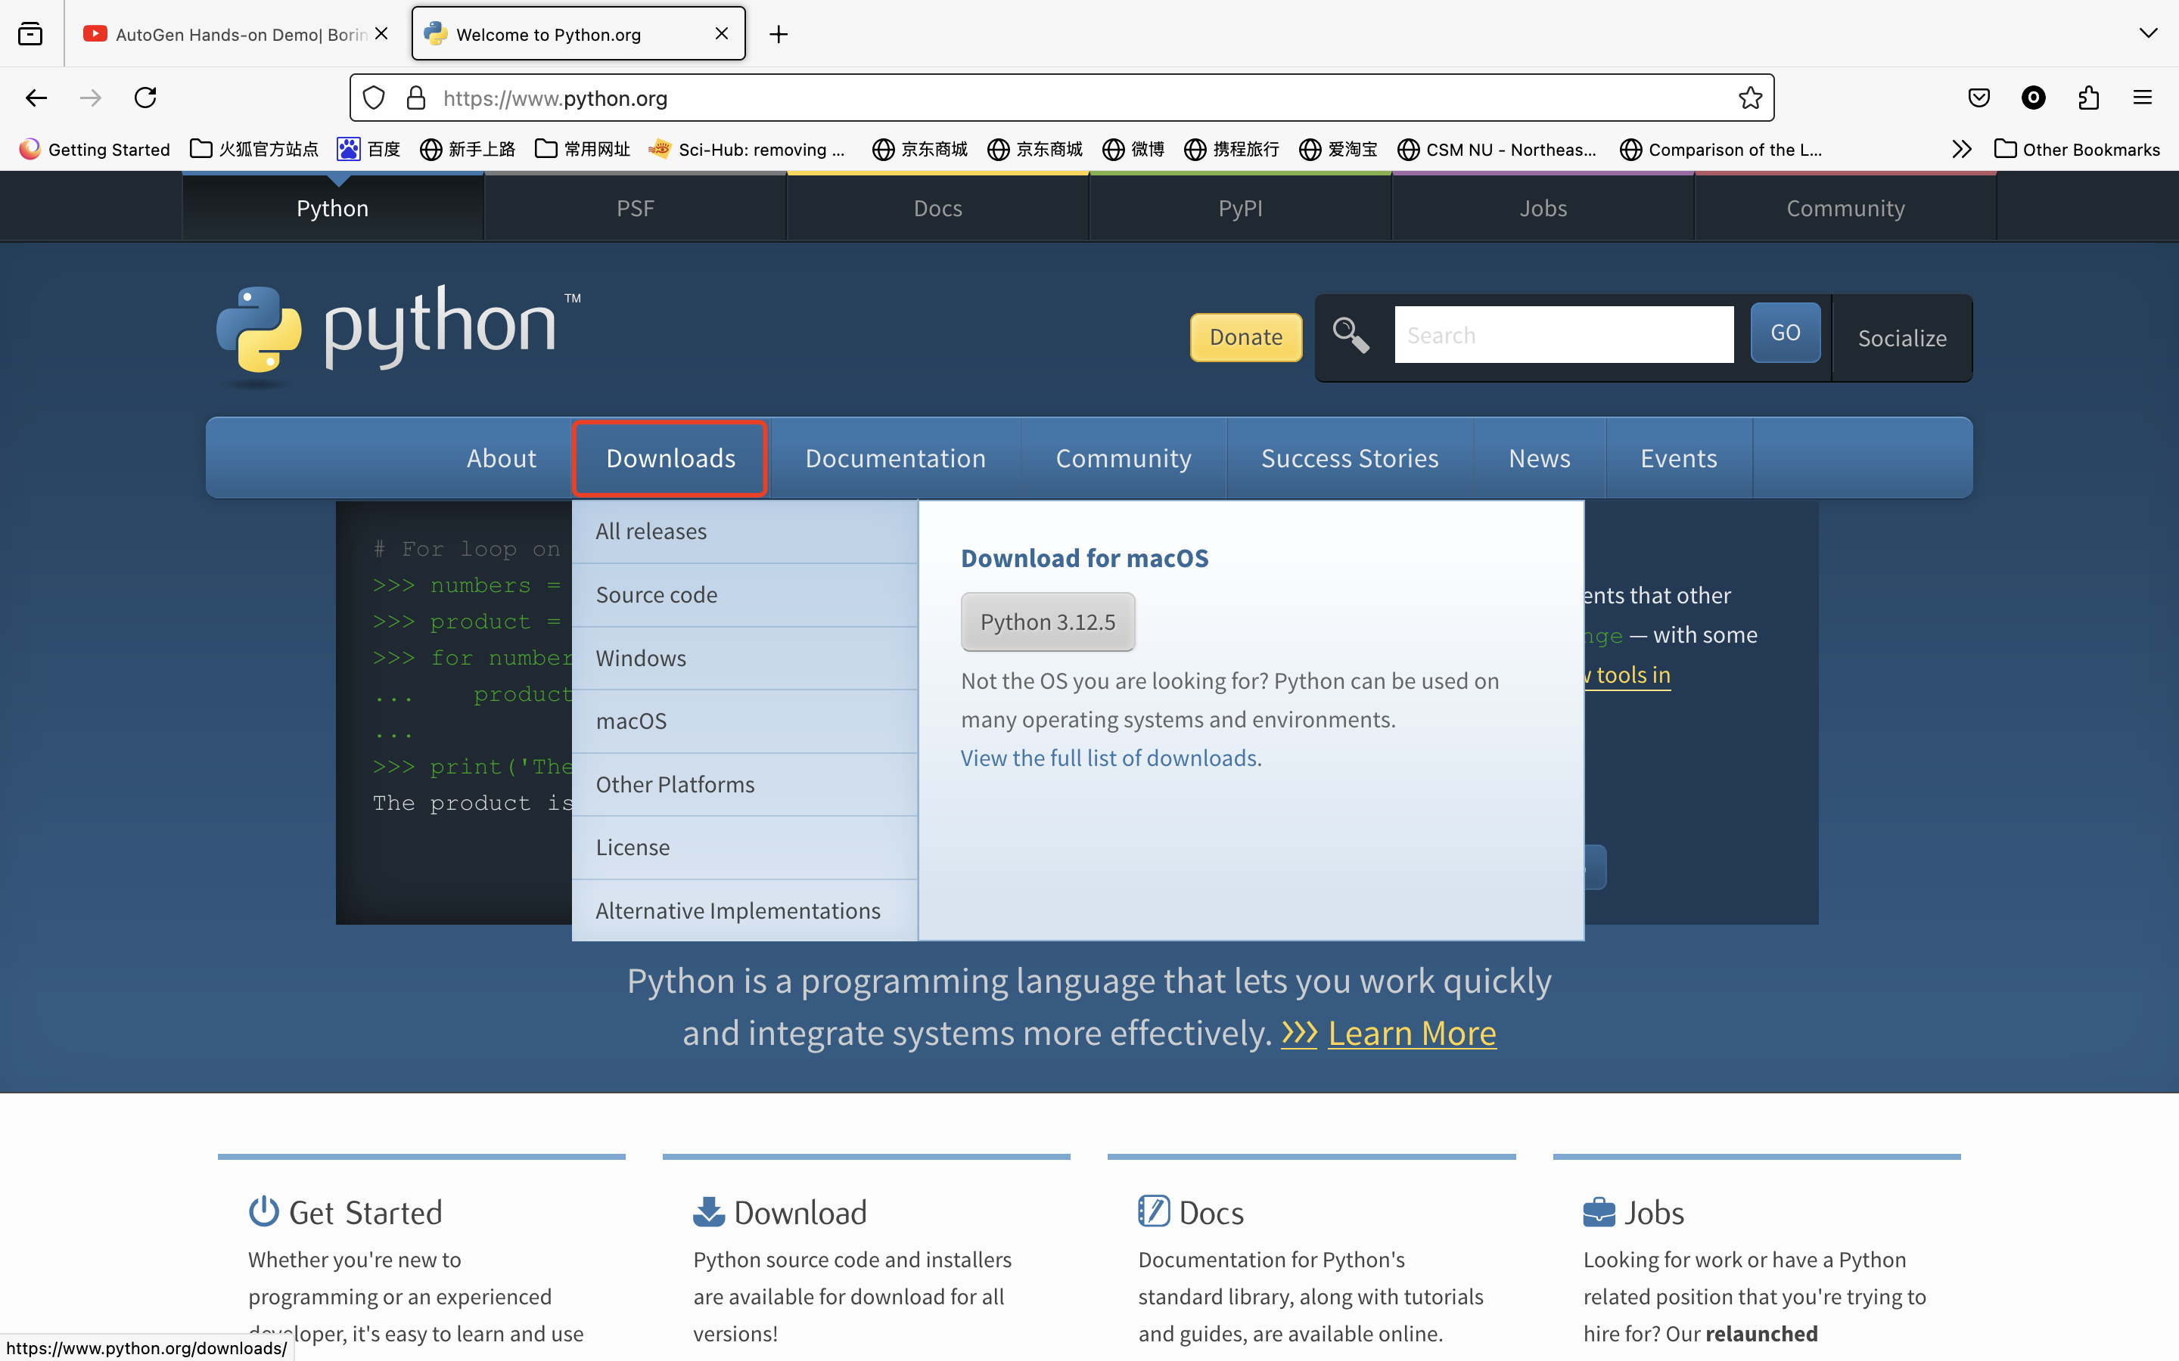
Python Install
download website: https://www.python.org/

Slide 3
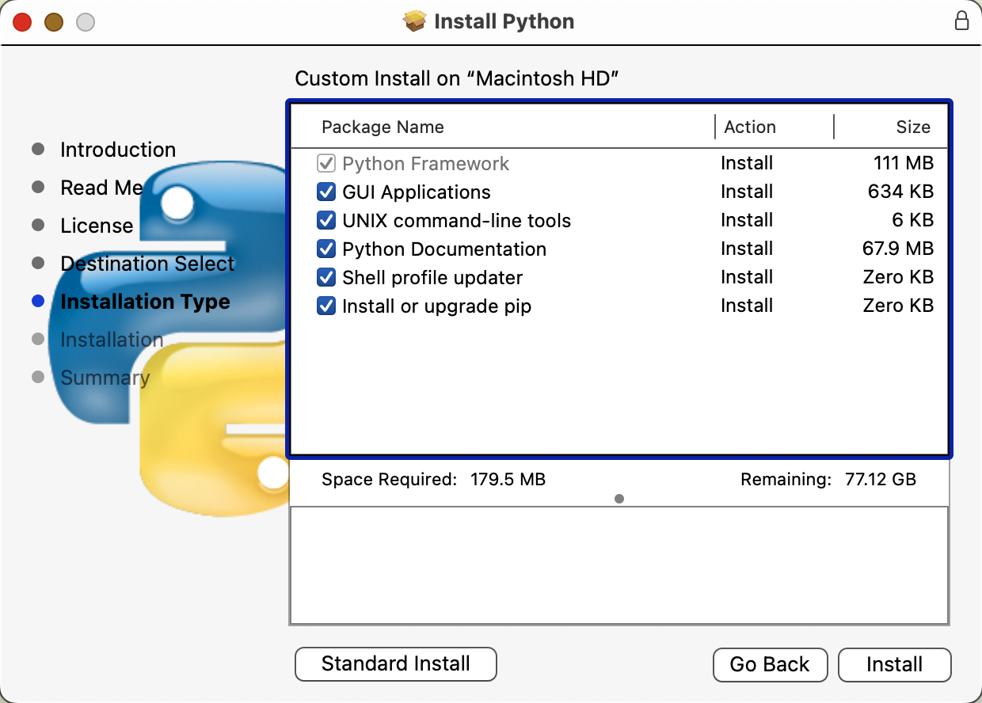
Python Install

Slide 4
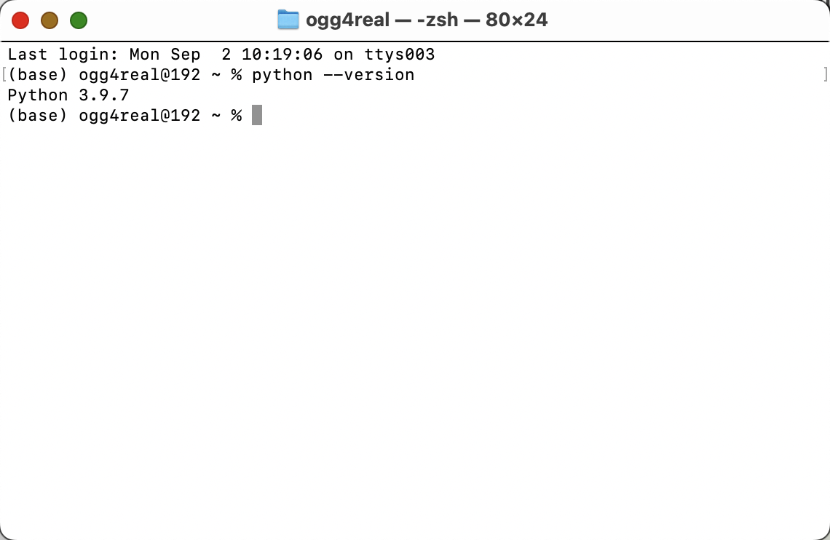
Python Install
After downloading,Check your Python version via Terminal or cmd
command: python --version

Slide 5
* Virtual Environment
A virtual environment is an isolated Python environment that includes a specific Python interpreter version along with associated packages, modules, and libraries.
venv:
• Supports only Python projects and relies on the Python interpreter installed on the system.
• The virtual environments created are lightweight, simple to use, and suitable for small and pure Python projects.
• Does not have package management functionality and relies on pip to install and manage packages.
Conda:
• Supports cross-language dependency management, making it suitable for projects involving multiple programming languages.
• Provides package management functionality, allowing management of not just Python packages but also other libraries and software tools.
• Can install different versions of the Python interpreter and manage them along with the virtual environment.
• Supports using the conda install command to manage packages within the environment, simplifying dependency installation and conflict resolution.

Slide 6
* Virtual Environment -venv
Using Command Line Tools:
• Windows: python -m venv myenv
• macOS/Linux: python3 -m venv myenv
Activate the Virtual Environment:
• Windows: myenv\Scripts\activate
• macOS/Linux: source myenv/bin/activate
Install Dependencies:
Use pip install package_name within the activated virtual environment to install the packages your project needs.

Slide 7
* Virtual Environment -conda
Install Conda:https://www.anaconda.com/download
Create a New Virtual Environment:conda create --name myenv
You can also specify the Python version if needed:conda create --name myenv python=3.8
After creation, activate your environment with:conda activate myenv
While in the activated environment, you can install packages using:conda install package_name
When you’re done, deactivate the environment with:conda deactivate

Slide 8


IDE Introduction
VS code
Jupyter Lab/Jupyter Notebook

Slide 9
VS Code
Visual Studio Code (VS Code) is a free, open-source code editor developed by Microsoft. It’s designed for building and debugging modern web and cloud applications.
Features include support for debugging, syntax highlighting, intelligent code completion, snippets, code refactoring, and embedded version control with Git. Users can change the theme, keyboard shortcuts, preferences, and install extensions that add functionality.
https://code.visualstudio.com/docs/introvideos/basics

Slide 10
Jupyter Lab
JupyterLab is an advanced, flexible IDE for data science and interactive computing. It builds on Jupyter Notebook, offering a modern, multi-document interface for running live code, creating visualizations, and writing text.
in terminal/cmd:pip install jupyter lab
in terminal/cmd: jupyter lab

